Slide 1


Slide 2

Irish Rural Link
Moate
2nd October 2023

Slide 3
Overview
SEAI Home Energy Grant Options
Reduce Your Use/Keep Warm and Well
Additional Resources

Slide 4
SEAI Home Energy Grant Options

Slide 5


Home Heat Loss and Energy Use
Where you lose energy in your home…
Roof 30%
Air infiltration 10%
Walls 30%
Doors & Windows 10%
Floors 20%

Slide 6

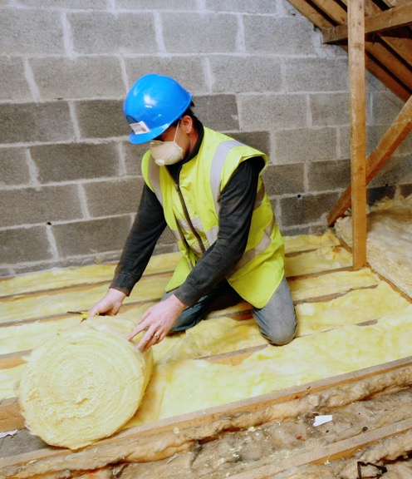
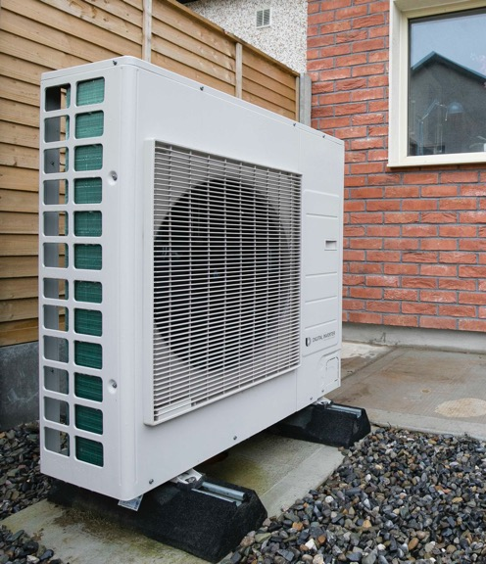
Three Steps to a Home Energy Upgrade
Maximise the comfort and savings of your home with these 3 steps to a home energy upgrade
Assess
Insulate
Add Renewables

Slide 7
Compare your Home Energy Upgrade Options
Fully Funded Energy Upgrade
One Stop Shop Service
Individual Energy Upgrades
For qualifying homeowners in receipt of certain welfare payments
Fully funded by SEAI
This service is managed by SEAI
Home survey
Contractor selection
Contractor works
Follow up BER
Complete home energy upgrade solution
Part funded by SEAI
One Stop Shop fully managed solution including grant application
Multiple energy upgrades
Pay for works net of eligible grant
Minimum number of energy upgrades and achieve a min B2
Selection of individual grants for home energy upgrades
Part funded by SEAI
Homeowner manages their own energy upgrade project
Contractor selection
Grant application
Contractor works
Pays for works and then claims grant back

Slide 8
Fully Funded Energy Upgrades
Delivering free energy upgrades to qualifying homeowners
who are in receipt of one of the following:
  Fuel Allowance
  One parent family payment
  Family income supplement
  Domiciliary care allowance
  Jobseeker’s allowance > 6 months & child under 7
  Carer’s allowance and lives with the person being cared for
  Disability Allowance for over six months and have a child under seven years of age
Fully funded and fully managed by SEAI through a panel of contractors
Carry out a Home Assessment to determine the upgrades needed
Assign a contractor to complete works
Carry out a follow up BER
Homes must be built and occupied before 2006 to be eligible

Slide 9
One Stop Shop Service
A complete home energy upgrade solution for homeowners and landlords
Supports multiple energy upgrades in one go to achieve a minimum B2 BER rating
Offers a wider range of grants offering up to 50% of the cost of works
To pay for the works net of the eligible grant
Fully managed solution from start to finish;
  Home Energy Assessment
  Contractor works
  Grant application
  Follow up BER
To carry out a minimum number of energy upgrades and achieve a minimum B2 BER
Homes must be built and occupied before 2011 to be eligible
Choose from the list of registered one stop shops on the SEAI website: www.seai.ie

Slide 10
Individual Energy Upgrade
For homeowners and private landlords who want to manage their own project
Range of individual energy upgrade grants for attic and wall insulation, heating and renewable technologies
Manage the grant application and works themselves
Homeowners pay for the cost of works and claim the grant afterwards
How to apply:
  Choose your energy upgrade and grant
  Select your SEAI registered contractor
  Submit your grant application – must have grant approval before works commence
  Get works done – 8 months to complete works and claim grant from date of approval
  Submit you grant payment request – 4 to 6 weeks for payment
Homes must be built and occupied before 2011 for insulation and heating controls, and before 2021 for renewable systems

Slide 11



Home Energy Upgrade Grants
 | Fully Funded Energy Upgrade | One Stop Shop Service | Individual Energy Upgrade
Home energy assessment
Project management
Wall and roof insulation
Floor insulation
Windows
Heating controls
Heat pump systems
Solar water heating
Solar electricity
Ventilation
BER assessment

Slide 12
Individual Energy Upgrade
For homeowners and private landlords wishing to manage their own home energy upgrade, there are a range of individual energy upgrade grants.
Energy Upgrades | Detached | Semi-Detached / End Terrace | Mid Terrace | Apartment
Heat Pump | €6,500 |  |  | €4,500
Heat Pump Air-to-Air | €3,500
Technical Assessment | €200*
Heating Controls only | €700
Ceiling Insulation | €1,500 | €1,300 | €1,200 | €800
Cavity Wall Insulation | €1,700 | €1,200 | €800 | €700
External Wall Insulation | €8,000 | €6,000 | €3,500 | €3,000
Internal Wall Insulation | €4,500 | €3,500 | €2,000 | €1,500
Solar Thermal | €1,200
Solar PV | 0 to 2 kWp €900/kWp 2 to 4 kWp €300/kWp
Represents 80% of total cost for an average home
* The grant for the Technical Assessment is only payable in conjunction with the Heat Pump System grant

Slide 13
One Stop Shop Service
You can access a wider range of grants using a One Stop Shop than if
you were to manage the project yourself.
Energy Upgrades | Detached | Semi-Detached / End Terrace | Mid Terrace | Apartment
Heat Pump | €6,500 |  |  | €4,500
Central Heating System for Heat Pump | €2,000 |  |  | €1,000
Heat Pump Air-to-Air | €3,500
Heating Controls only | €700
Launch bonus for reaching B2 with a Heat Pump | €2,000
Ceiling Insulation | €1,500 | €1,300 | €1,200 | €800
Rafter Insulation | €3,000 | €3,000 | €2,000 | €1,500
Cavity Wall Insulation | €1,700 | €1,200 | €800 | €700
External Wall Insulation | €8,000 | €6,000 | €3,500 | €3,000
Internal Wall Insulation | €4,500 | €3,500 | €2,000 | €1,500
Windows (Complete Upgrade) | €4,000 | €3,000 | €1,800 | €1,500
External Doors (max. 2) | €800 per door
Floor Insulation | €3,500
Solar Thermal | €1,200
Solar PV | 0 to 2 kWp €900/kWp 2 to 4 kWp €300/kWp
Mechanical Ventilation | €1,500
Air Tightness | €1,000
Home Energy Assessment | €350
Project Management | €2,000 | €1,600 | €1,200 | €800

Slide 14
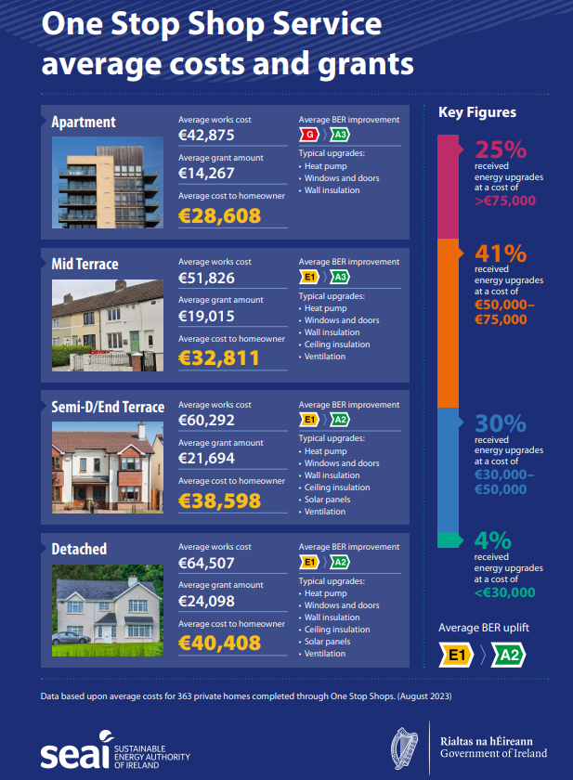
One Stop Shop Service
Apartment average cost to householder was €28,608 with a grant of about 33%
Mid terrace average cost to householder was €32,811 with a grant of about 37%
Semi-detached average cost to householder was €38,598 with a grant of about 36%
Detached average cost to householder was €40,408 with a grant of about 37%

Slide 15



Over 455,000 homeowners have already started their Home Energy Upgrade with grants from SEAI
Reduce your
energy bills
Make your home
warm and comfy
Reduce your
carbon footprint

Slide 16
Stay Warm and Well/Reduce Your Use

Slide 17

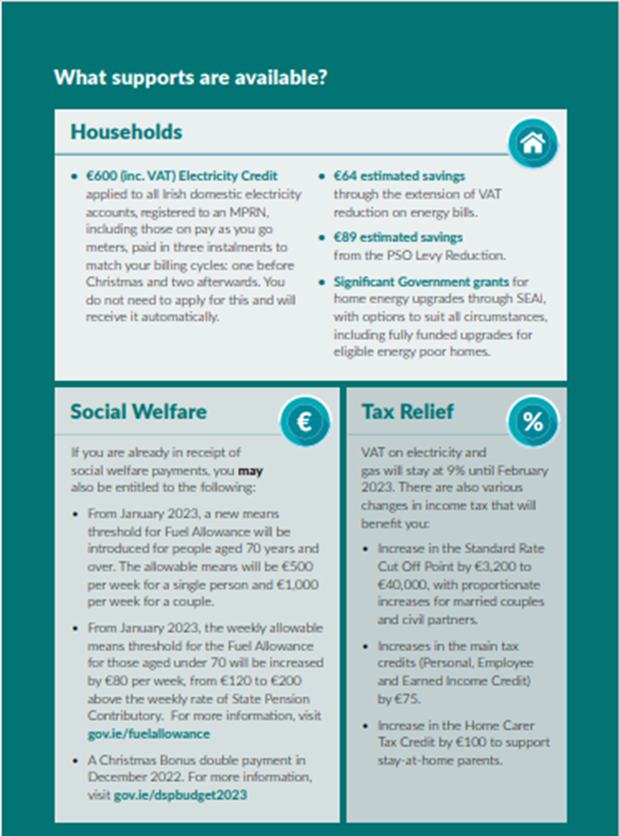
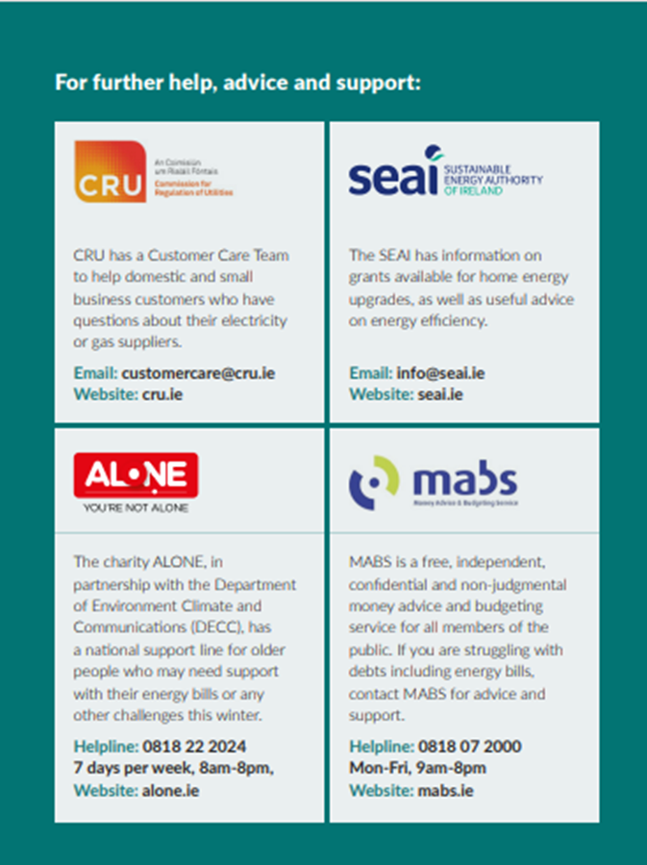
Stay Warm and Well

Slide 18
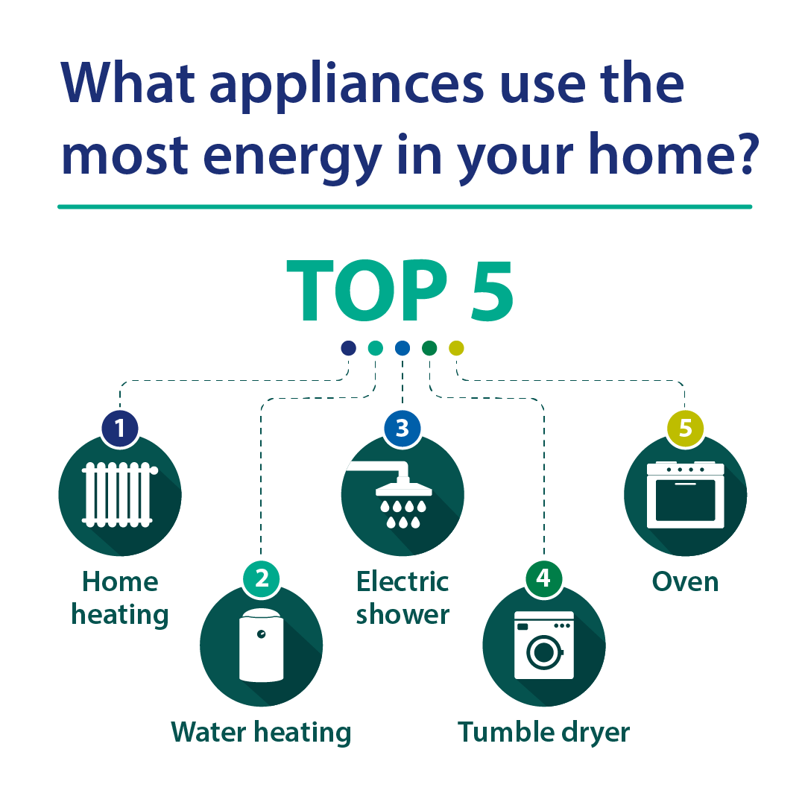

Slide 19
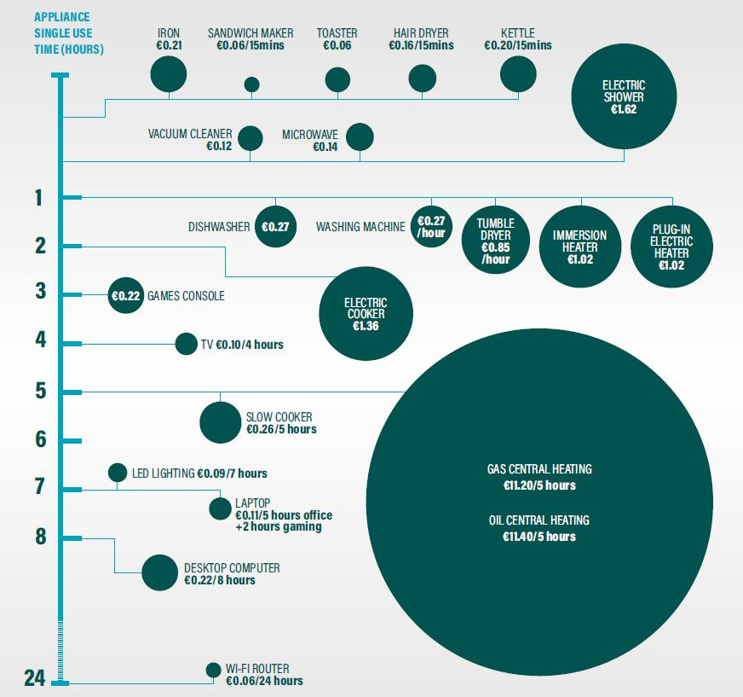

Slide 20
Additional Resources

Slide 21





















































OVER 750 COMMUNITIES
Part of SEAI’s Sustainable Energy Communities Network
MORE THAN
37,500
BORDER/WEST
OVER
CITIZENS ENGAGED
200
122
DUBLIN/
ENERGY MASTERPLANS COMPLETED
COMMUNITIES
MID EAST
185
OVER
MIDLANDS/
SOUTH EAST
175
OVER
COMMUNITIES
77
COMMUNITIES
MID WEST/
SOUTH WEST
200
OVER
COMMUNITIES
Are currently working on their Energy Master Plans
COMMUNITIES
Find out more at: www.seai.ie/sec

Slide 22
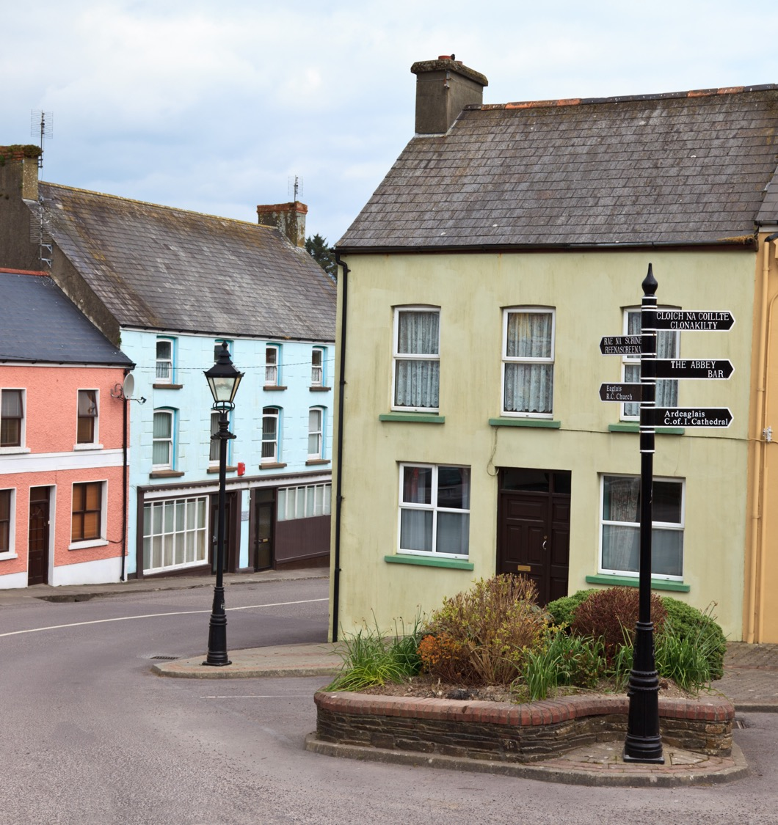

Communities Grant
Providing capital funding, partnerships, and technical support to assist energy efficiency in community projects
Community oriented with a cross-sectoral approach
Encouraging smaller projects from €50k to large projects up to €2m
Fixed Grant values for homes
2022: Funded projects to the value of €12 m
  Upgraded 295 residential buildings to a minimum B2 rating
  Upgraded 56 non-residential
Notes:
Assisting energy efficiency community projects through capital funding, partnerships, and technical support.
Delivering energy savings to homeowners, communities, and private sector organisations.
Community oriented with a cross-sectoral approach,
and you must show that you can sustainably finance
the proposed project
Encouraging smaller projects from €50k to €1.5m.
Grant values range from 35%, to 80% for fuel poor homes
2020: Delivered 25 projects with funding of €18.5m. Upgraded 656 residential buildings to a minimum B2 rating and upgraded 240 non-residential.

Slide 23




Community Renewable Energy Support Scheme
New Government scheme to support the development of renewable electricity projects in Ireland
A dedicated Community strand – for those who want to generate renewable power
SEAI is offering support. We will help you navigate your way through the journey
  Expert support
  Financial support
  Information toolkit
Further details email: communityress@seai.ie
Notes:
New Government scheme to support the development of renewable electricity projects in Ireland
Auction system – renewable generators compete against each other for contracts by bidding in a price for the power they can provide
For Communities there are two main areas
A dedicated Community strand – for those who want to generate renewable power
SEAI are offering support to communities interested in developing their own renewable electricity generation projects and who are seeking to bid in the renewable auctions. We will help you navigate your way through the journey.
Further details email: CommunityRESS@seai.ie
There is also
Community Benefit Fund – for communities in the area of a renewable project a €2 per Megawatt hour of generation will be provided

Slide 24



Toolkit - Guides

Slide 25
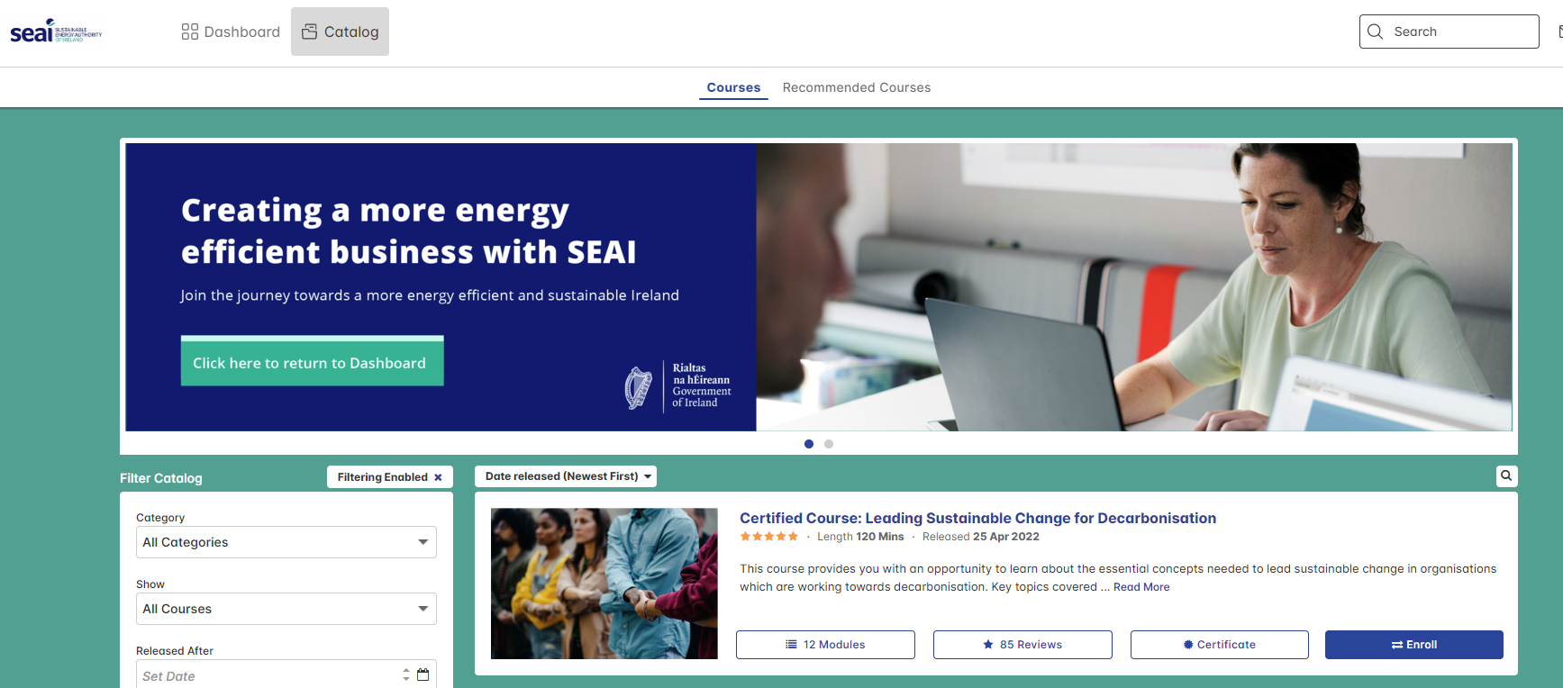
Business Supports - Understand Your Energy Use
SEAI Energy Academy
SEAI’s free e-learning platform
Understand your energy use and increase your knowledge of energy related topics
Reduce your energy bills by up to 10%
24 modules available including;
  Energy and Climate Change
  Decarbonisation for Business
  Business Energy Efficiency ​
  Introduction to Electric Vehicles
  Introduction to Solar PV
Join the SEAI Energy Academy
www.seai.ie/energyacademy
Notes:
Click on the image to play the short video which shows part of the Business and Energy Efficiency module.
The SEAI Energy Academy is an free e-learning platform designed to help businesses learn about how energy is used in their business.
It’s the first step for any business on their energy efficiency journey and can be accessed 24/7 at a time that suits you.
We encourage CEO’s and operational managers to join the Energy Academy, but anyone can join. Some businesses have rolled-out the Energy Academy to all employees as part of a sustainability initiative.
Businesses can save up to 10% on their energy use through behavioural change techniques and you can learn about these on the Energy Academy.
There are 24 modules available on the Energy Academy including decarbonisation for business, energy and climate change, solar pv, and electric vehicles.

Slide 26

Business Supports - Complete an Energy Audit
Support Scheme for Energy Audits
Offers SMES a voucher of €2,000 to get an energy audit
Audits are carried out by an SEAI Registered Energy Auditor – the list of participating auditors is available online
To be eligible, your company must: spend at least €10,000 on energy per year, have a valid CRO number, and be tax compliant
Find out more and apply online: https://www.seai.ie/sme/energyaudits
Notes:
Offers small and medium enterprises (SMES) a voucher of €2,000 to get an energy audit
Audits are carried out by an SEAI Registered Energy Auditor – the list of participating auditors is available online
You can apply online and, if you are eligible, the voucher will be automatically issued to you via email
To be eligible, your company must: spend at least €10,000 on energy per year, have a valid CRO number, and be tax compliant
Find out more and apply online: https://www.seai.ie/sme/energyaudits

Slide 27

Electric Vehicles Grant
What is it for:
New Battery Electric Vehicles (BEV)
Who is eligible:
Private purchase, Demo Vehicles
Commercial Vans (N1)
How much is the grant:
Grant amount is linked to vehicle list price
Maximum €3,500 for passenger vehicles
Maximum €3,800 for (N1) commercial vans
How to apply:
Your car dealer will apply for you

Slide 28
Thank you for listening ruth.buggie@seai.ie
Grant queries: 01-808 2100
For more information visit seai.ie

