Slide 1
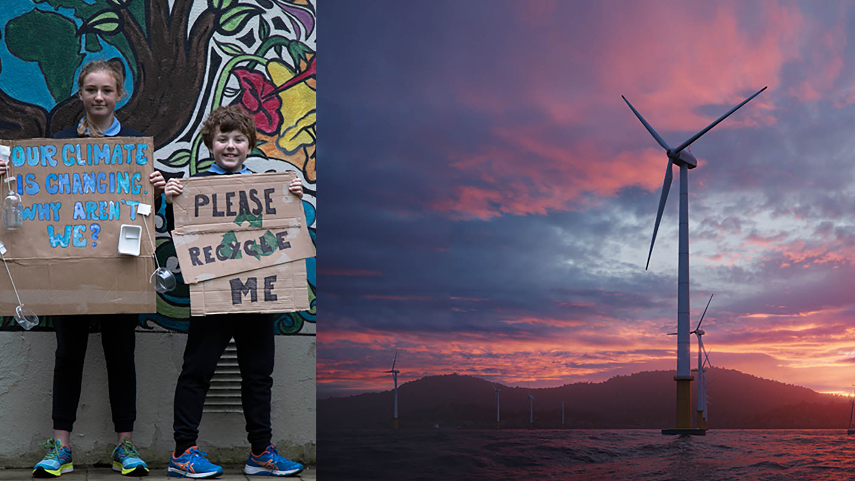
Shaping our electricity future
Preparing for at least
70% clean electricity by 2030

Slide 2
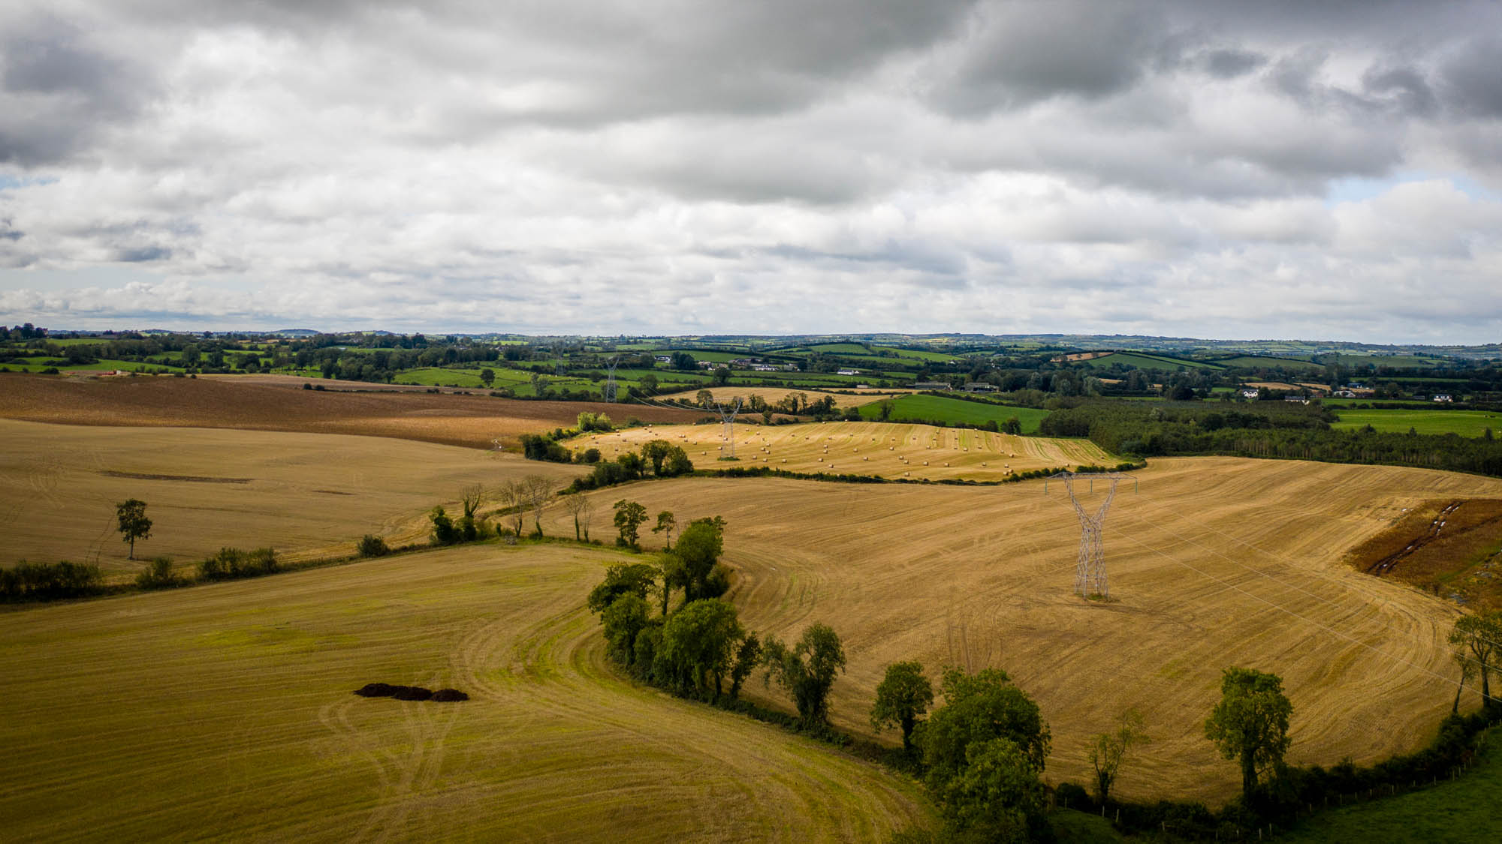
EirGrid operates and develops the electricity grid in Ireland. We send power from where it is generated to where it is needed.

Slide 3
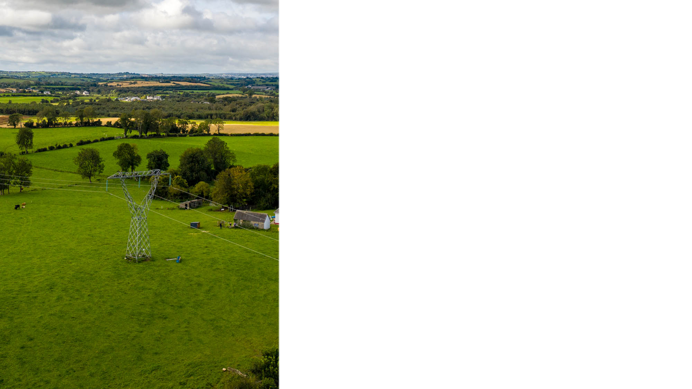
Introduction to EirGrid
We are owned by the Irish Government, and we are a regulated utility. This means we operate solely for the benefit of the electricity user.
We do not generate electricity – we bring it from generators across the grid. We also operate some interconnectors with neighbouring electricity grids.
We run the wholesale electricity market. This ensures electricity is always available at the most economic price possible.
We do not own the electricity grid, and have no vested interest in adding to it.
We only upgrade or add to the grid in response to government policy, or where it is an essential response to secure Ireland’s electricity supply.

Slide 4
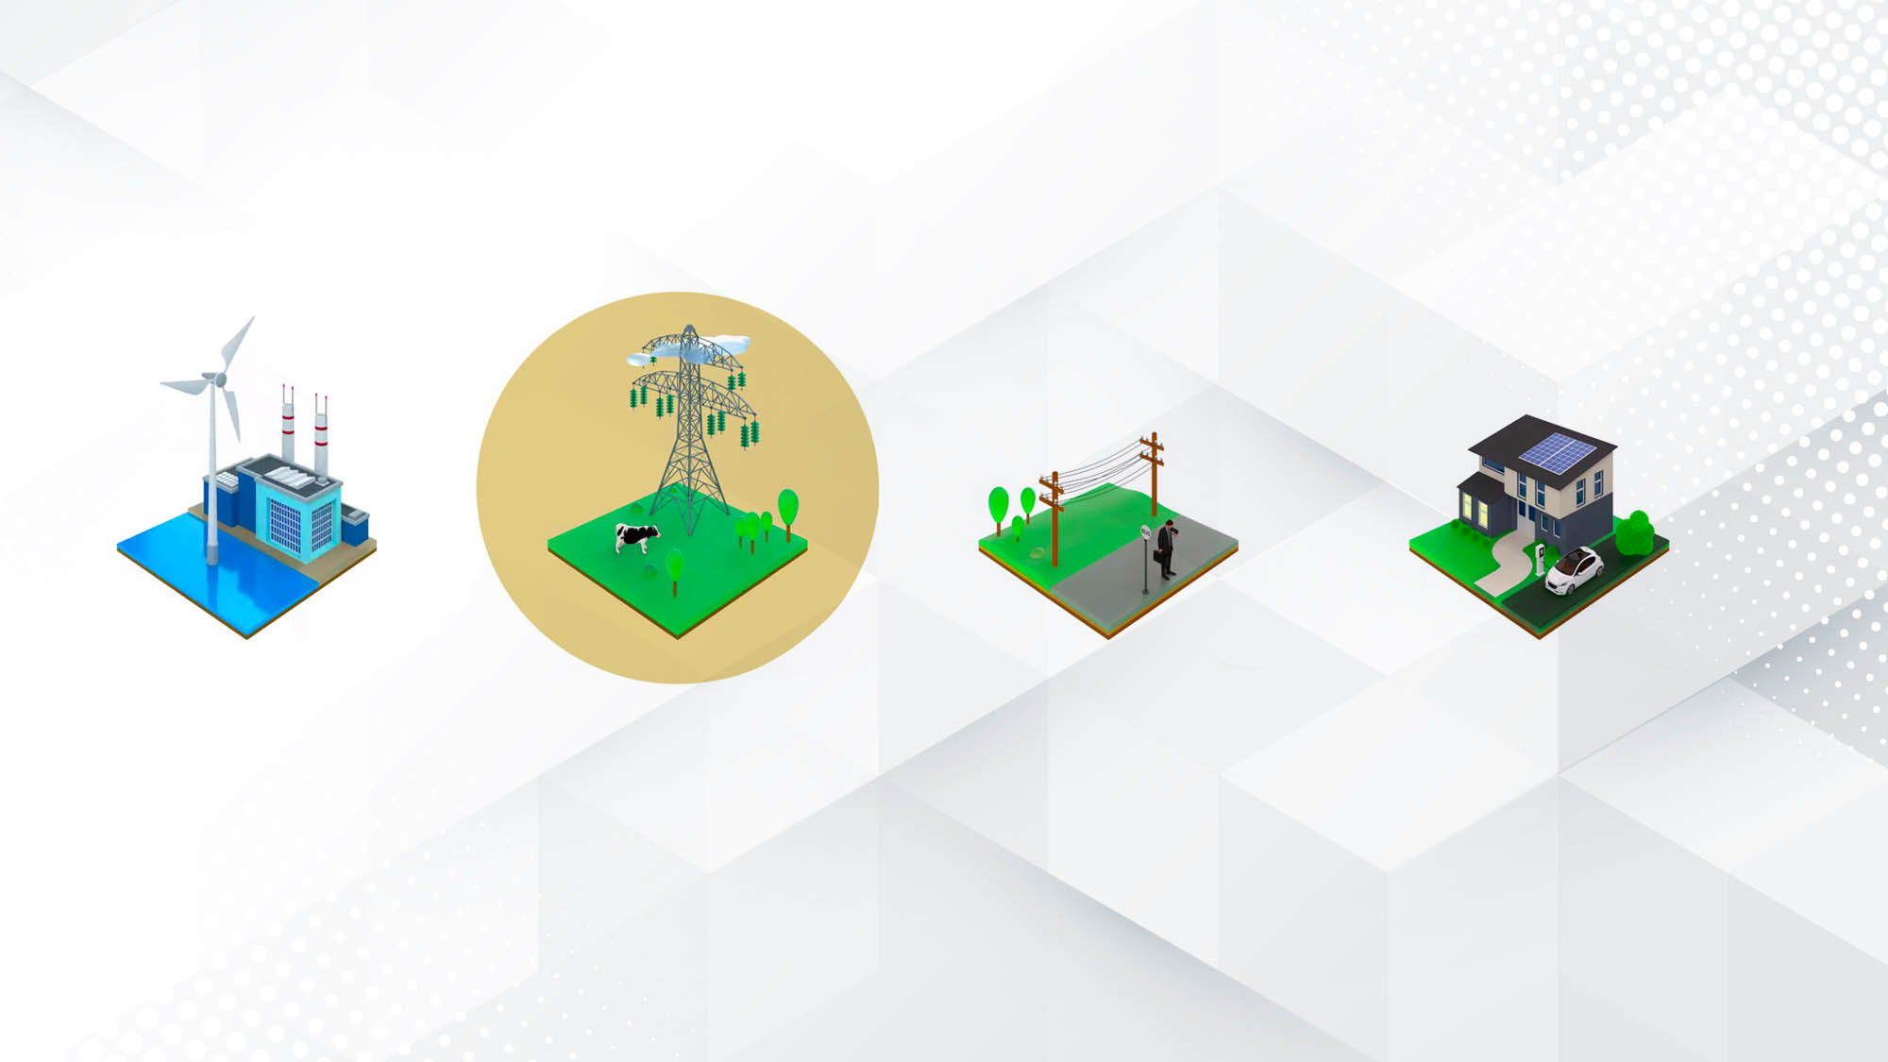
How does the grid work?
Generation companies create electricity and compete to supply it at the best price.
EirGrid ensures there is enough electricity, then safely delivers this directly to large energy users and all around the grid.
ESB Networks take electricity from the grid and send to everyone who needs it.
Consumers choose an electricity supplier, confident that they’ll have a reliable and secure supply – now and in future.

Slide 5

Why is electricity a solution to climate change?
Burning fossil fuels creates carbon emissions
Carbon emissions create climate change
Electricity can be generated from clean and renewable sources with no carbon emissions
Clean electricity from renewable sources will replace fossil fuels

Slide 6
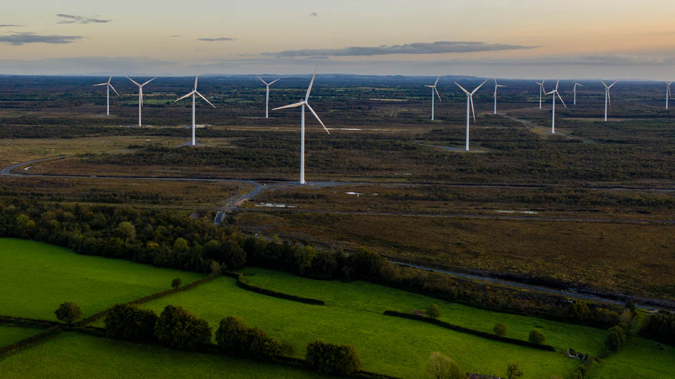
In response, the Government has asked us to prepare the grid so at least 70% of Ireland’s electricity can come from renewable sources by 2030.

Slide 7
Clean electricity drives the Climate Action Plan

Slide 8

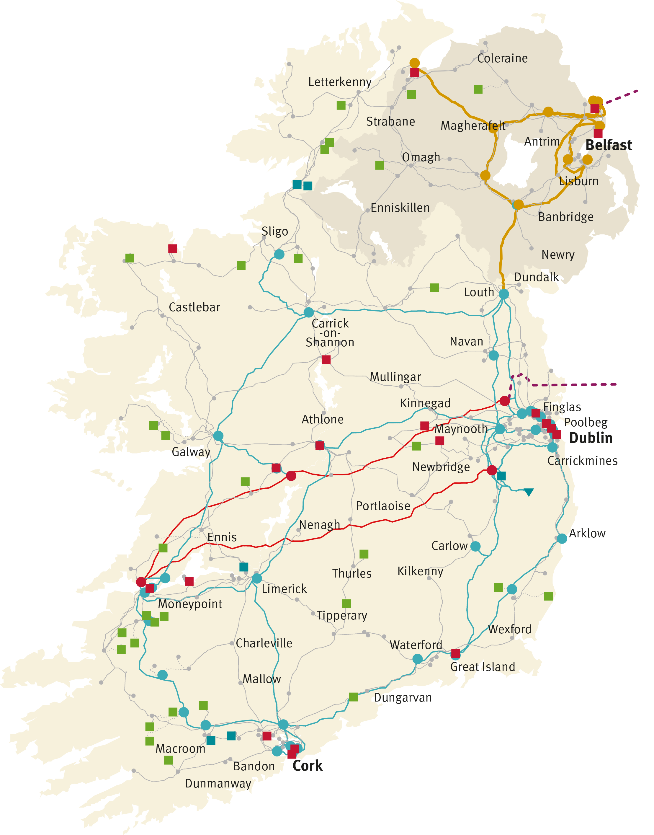
Ireland’s electricity grid

Slide 9
Ireland’s electricity grid

Slide 10
Ireland’s electricity grid

Slide 11



Ireland’s electricity grid
More electricity will be carried across this grid than ever before, and most of this power will come from renewable sources.
The grid needs to carry at least
10 GW more renewable electricity by 2030 – double 2020 levels.
Power output from renewable sources depends on the weather.
Renewable electricity is typically generated far away from where most electricity is used.

Slide 12
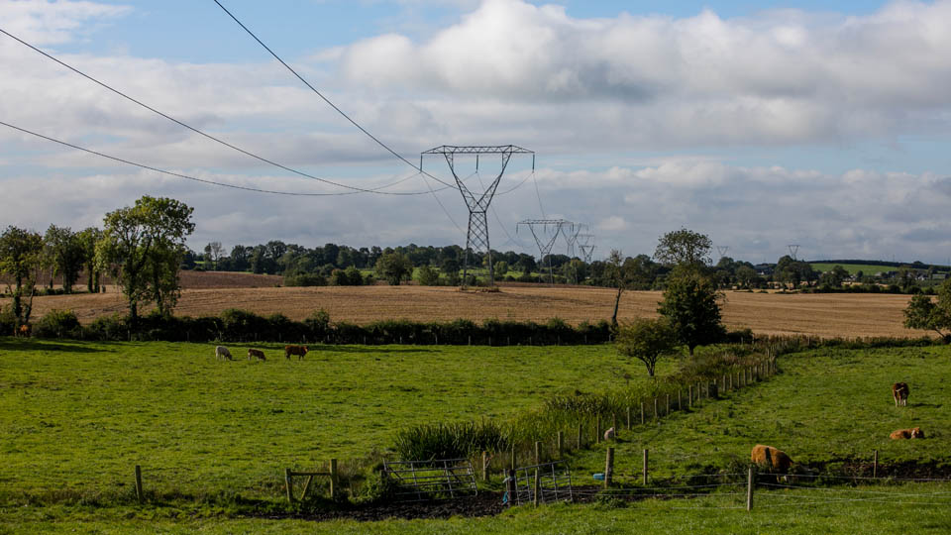
To achieve at least 70% clean electricity by 2030, we need to make the grid stronger and more flexible.

Slide 13

How should we achieve this goal?
Four draft approaches to reach 70% by 2030
Our final plan will include elements of all approaches, strongly led by one of them.

Slide 14

Partners for progress
The goal of 70% by 2030 is driven by government policy.
Achieving this goal will need flexibility and innovation right across the electricity sector.
Some of the approaches depend on the actions of stakeholders to succeed.
All approaches need timely public consent – which is why we’re consulting so extensively.

Slide 15

Government policies would determine the best location of new renewable generation.
Preferred locations will consider the strength of the existing grid and the local demand.
Likely to lead to more offshore wind generation close to major cities, with less need for new onshore renewable generation.
Requires around 38 Projects / €0.7bn
4.5 GW offshore wind (east coast)
1 GW solar energy and inland wind farms
Highly likely to succeed

Slide 16

Continue to connect new sources of renewable electricity in any location that developers request.
This will create a need for a very large number of grid development projects – that cannot be delivered for many years after 2030.
This approach would also see more power being generated than can be used.
Requires over 77 Projects / €1.9bn
4 GW from inland wind farms
2 GW each from solar and offshore wind
Highly unlikely to succeed.

Slide 17

Use innovative ways to move clean electricity from the west coast to the east coast.
This will involve isolated underground cables carrying high voltage direct current – directly from renewable sources to east cost cities.
These cables would not integrate with the rest of the grid. They need large, expensive and complex converter stations at both ends of each cable.
Requires over 46 Projects / €1.5bn
4 GW from inland wind farms
2 GW each from solar and offshore wind
Very challenging to complete in time.

Slide 18

Government policies would determine the best location for large-scale electricity users. These users, such as data centers, could use 27% of all the electricity on the grid by 2030.
This means new high-demand customers would locate closer to sources of renewable electricity, and where the grid is already strong.
Requires over 41 Projects / €0.5bn
4 GW from inland wind farms
2 GW each from solar and offshore wind
Requires large electricity users to locate in preferred locations to succeed.

Slide 19
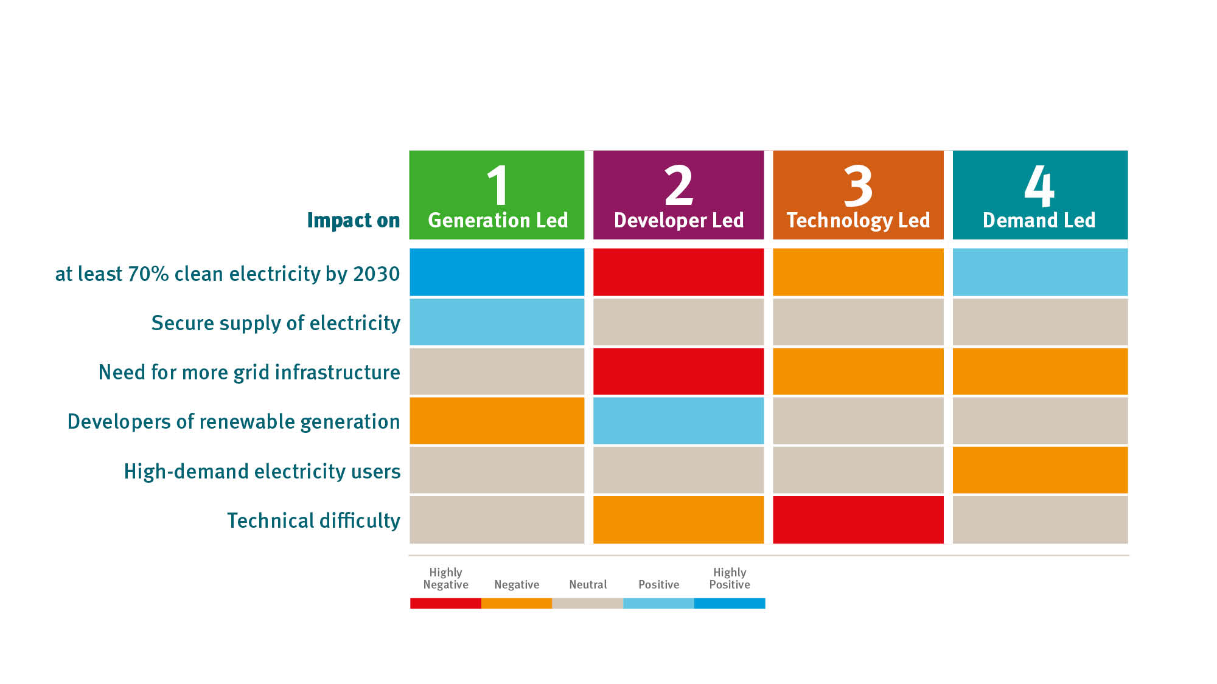
How do these different approaches compare?

Slide 20
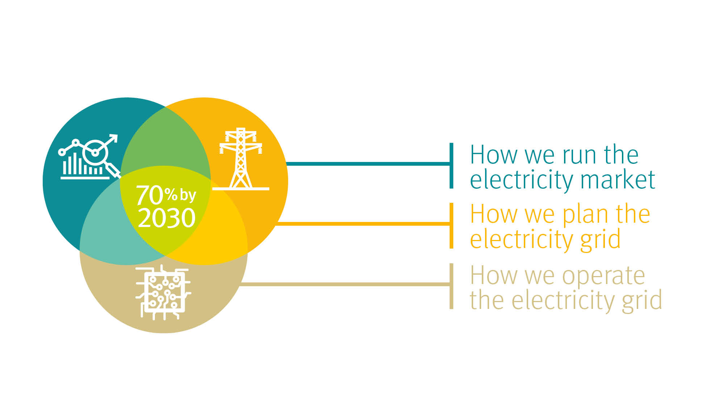
What must change to reach at least 70% by 2030?

Slide 21

What must change to reach at least 70% by 2030?
How we operate the electricity system
Many technical issues to run the grid when most power comes from renewable sources.
Principal challenge: electricity generated from renewable sources has a different frequency to electricity generated from burning fossil fuels.
Overriding goal is to ensure your supply of electricity remains secure and stable.
New technical solutions, policies and tools needed.
Consulting with electricity sector to find the best response.

Slide 22
What must change to reach at least 70% by 2030?
How we run the electricity market
We don’t generate electricity – we operate all-island markets that allow generators compete to supply power.
These markets are subject to regulatory rules, largely driven to the goal of achieving the lowest possible price.
Lowest possible price for renewable electricity is much lower than fossil-fuel generation: This model will not sustain the cost of developing new sources of clean electricity.
The markets also need to fund investment in technical solutions to maintain the resilience of the electricity system when there is less wind or sun.
Consulting with electricity sector to find the best response.

Slide 23

Our four draft approaches to reaching at least 70% by 2030 are open for consultation. Your views will shape our final plans at the end of this year.

Slide 24

Our plans to hear
the views of stakeholders
Working with Irish Rural Link to host workshops for communities across Ireland.
Working with Chambers Ireland to host workshops for businesses across Ireland.
Working with the National Youth Council of Ireland to host a Youth Assembly for future electricity consumers.
Hosting an Industry Forum for generation companies and developers, large energy users and suppliers.
Hosting a Civic Society Forum including academia, agriculture, community, environment, sustainable development and social justice.
We will also be hosting a public forum, like the Citizens’ Assemblies run by the Government.

Slide 25

In your area
Onshore wind and solar PV connections
Celtic Interconnector
Future of Moneypoint

Slide 26

How to submit your views
Complete the survey or make a submission to the Public Consultation at: https://consult.eirgrid.ie/
Send an email to consult@eirgrid.ie
Send your submission by post:
Shaping our Electricity Future
EirGrid, Freepost FDN 5312
160 Shelbourne Road
Ballsbridge, D04 FW28
Deadline is 12 noon on 14 June 2021

Slide 27
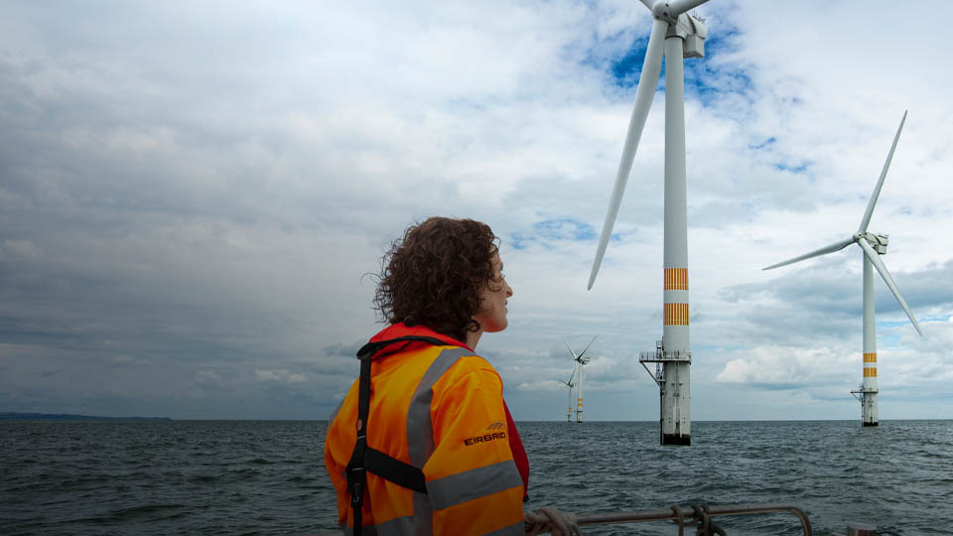
With your help, we can continue to lead the world in how much of our electricity comes from clean, renewable sources.

Slide 28
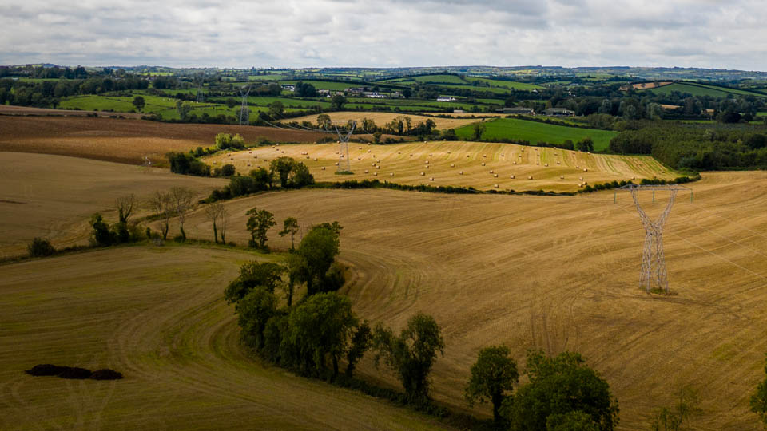
Ireland can make a meaningful difference to a global crisis, but it will mean embracing and accepting change. There may be local impacts, but they will benefit us all for generations.

Slide 29

We are committed to a
collective and collaborative form of decision-making. We want to hear from you to shape our final plans.

